Slide 1
Cricket League and Teams

Slide 2
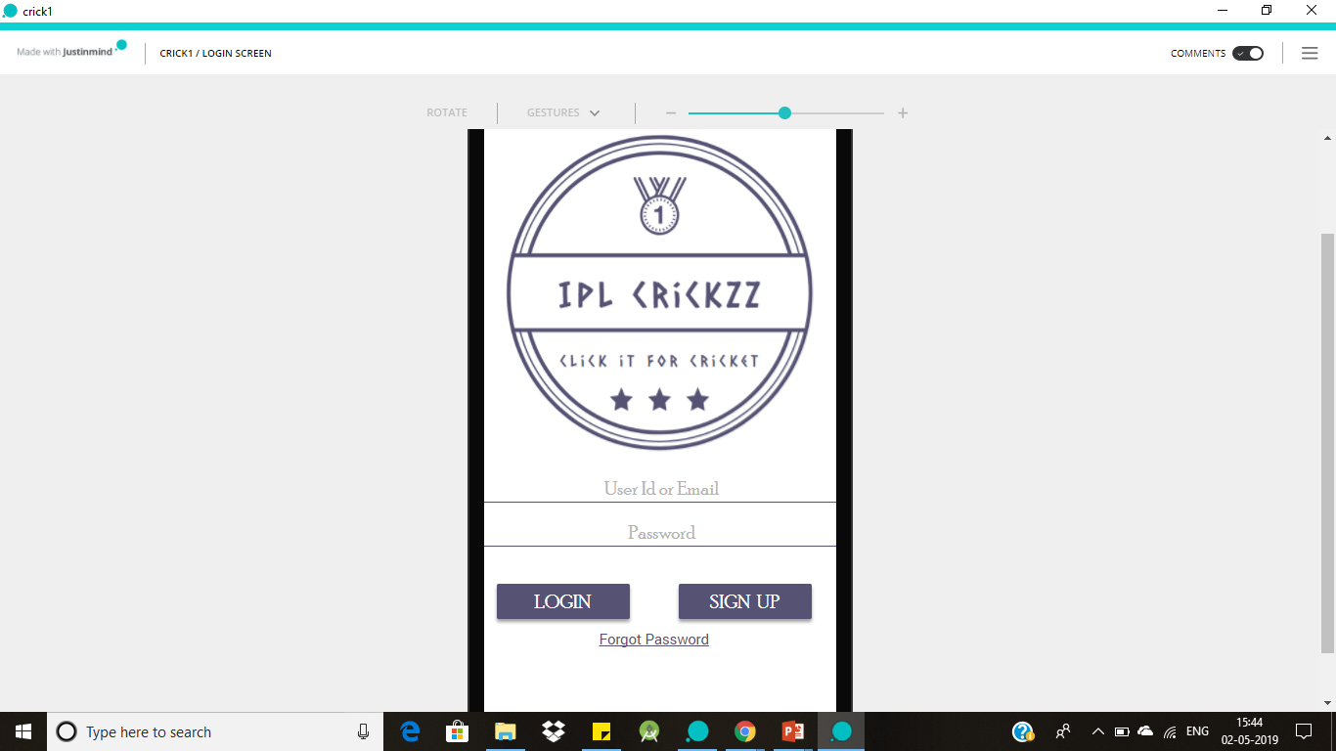
Login Screen
This Screen allows the user to create the account in the application and once the account is created user able to login into the application using login credentials.
If the user forgot the application credentials using forgot Password option they can retrieve the account.

Slide 3
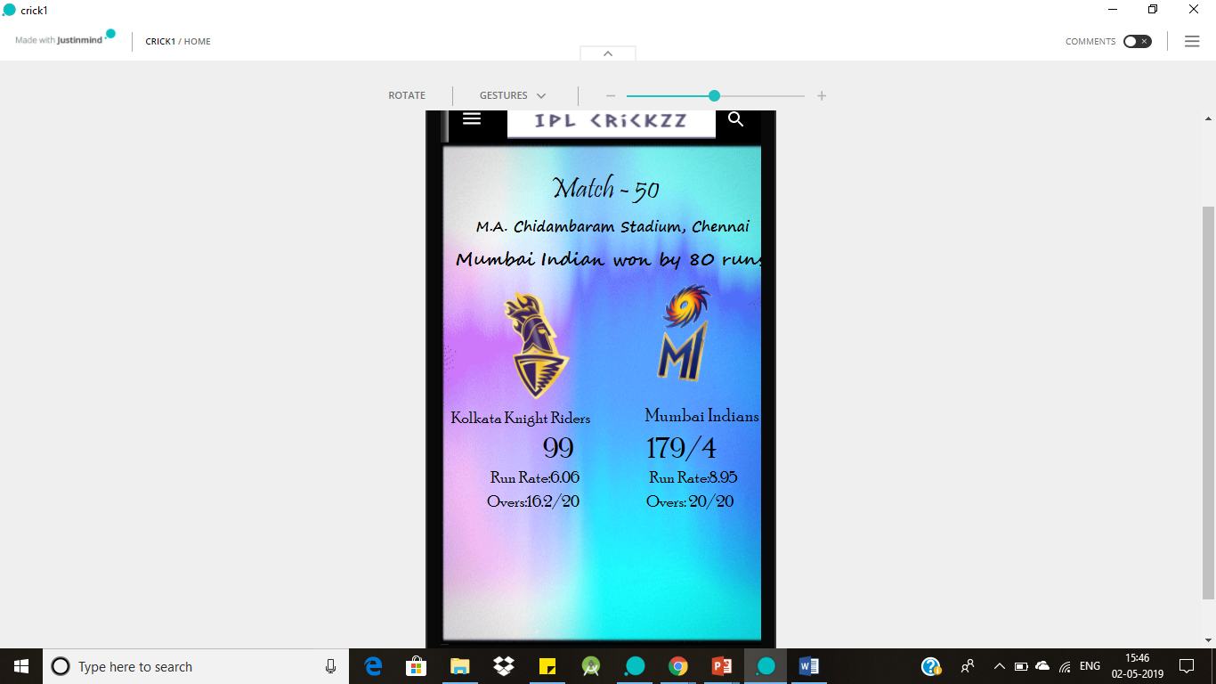
Home Screen
On Home Screen we can see the league matches schedule and live score of the ongoing match. In a short way we can say all the updates of the league can see on the Home Screen.

Slide 4
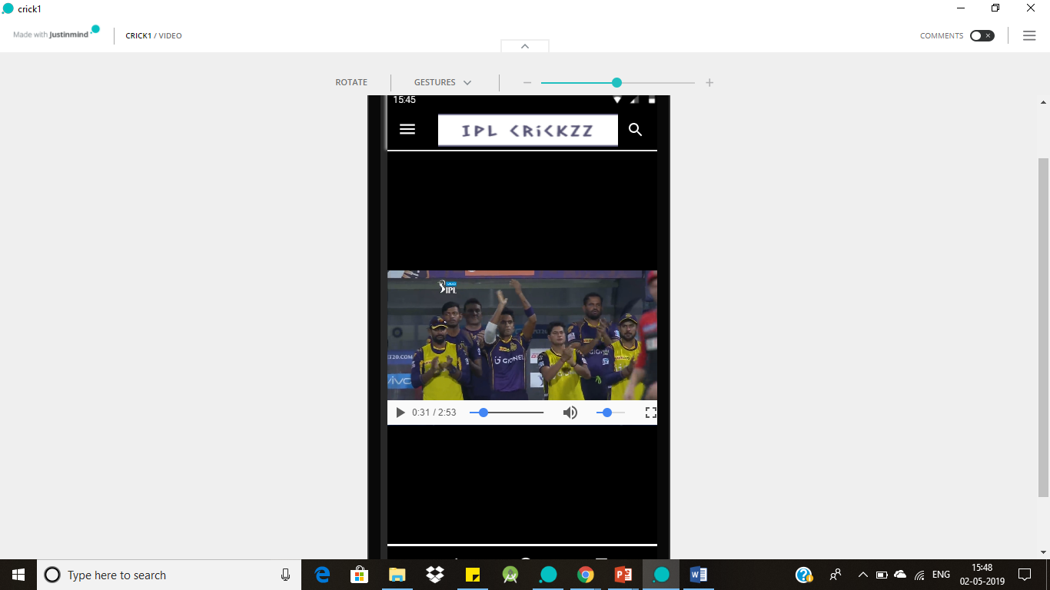
Videos Screen
In this screen application shows all the videos related to match reviews, Highlights of the match and also reviews of the cricket experts on the ongoing match.
User can easily switch from one video to another just by clicking on the video.

Slide 5
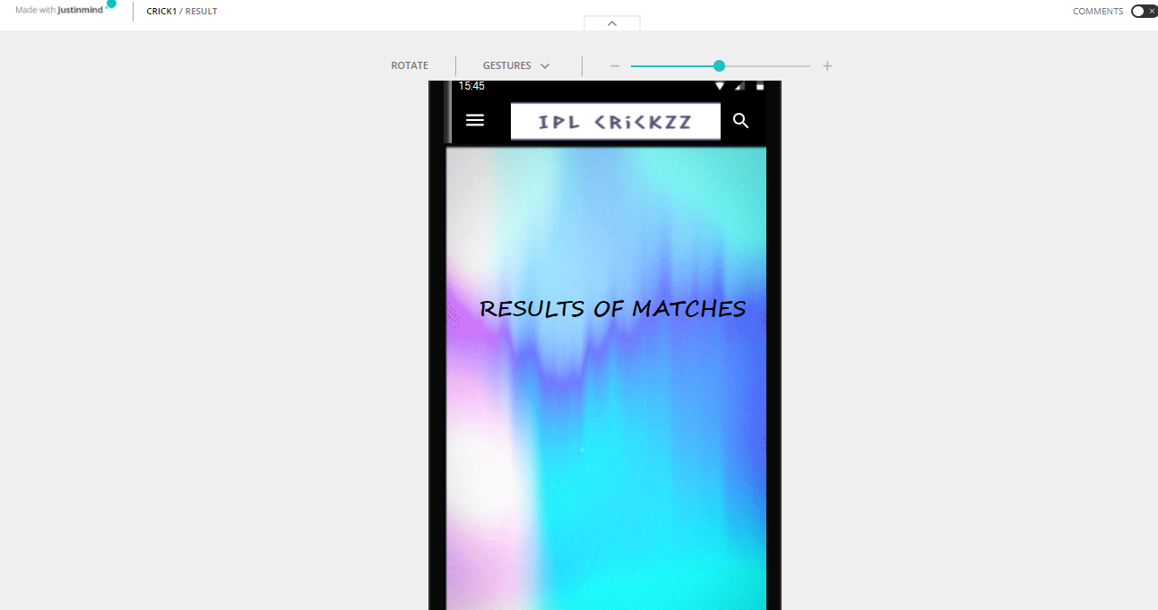
Results Screen
This screen shows all the results of the matches in the league and it clearly gives a summary of the match i.e., clear description of scorecards of both the teams.

Slide 6
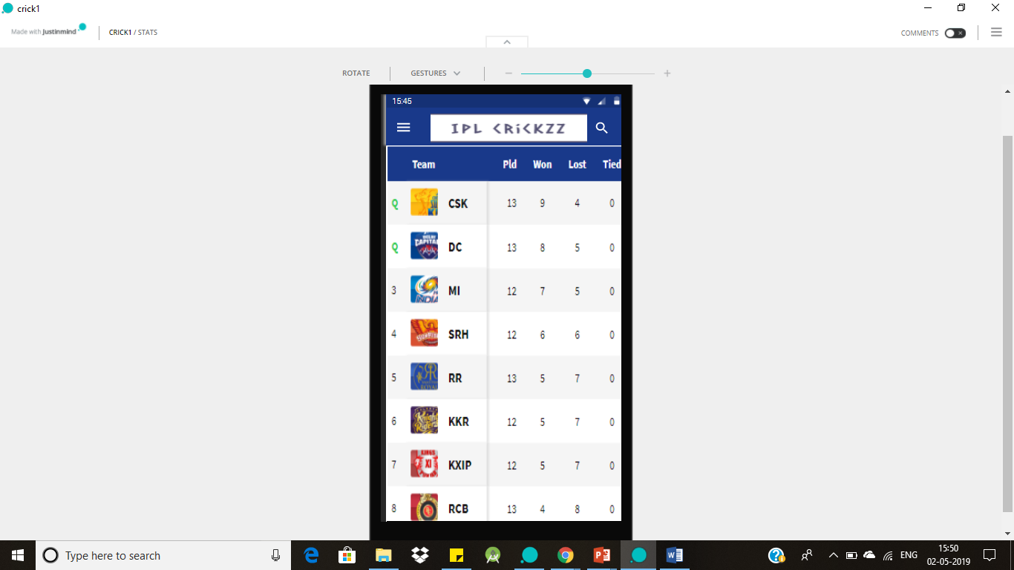
Points Table Screen
After the result of every match there should be a page which shows the position of the every team in the league.
This screen gives the information to the customer that which team is leading in the tournament and what are the teams going to clear playoffs all the information is recorded in the Points table screen.

Slide 7
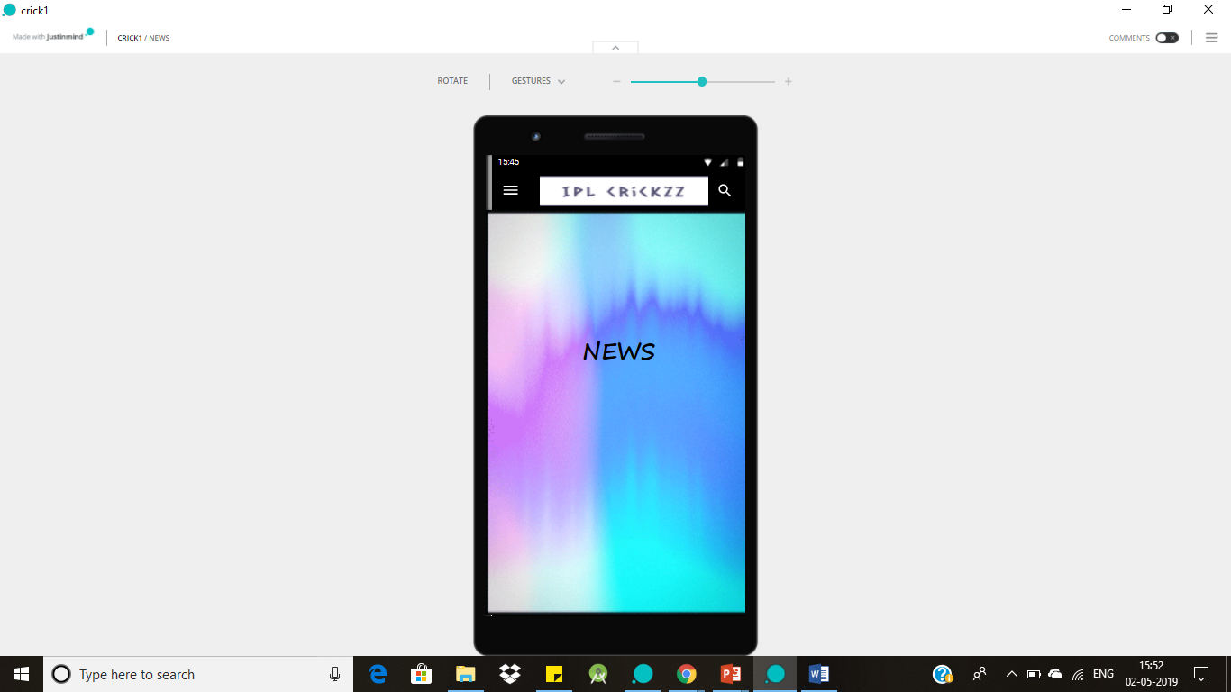
News Screen
This screen provides the information regarding the upcoming matches in the league and also the match reports of the league.
This screen also provide the information of Probable XI of teams before match start.

Slide 8
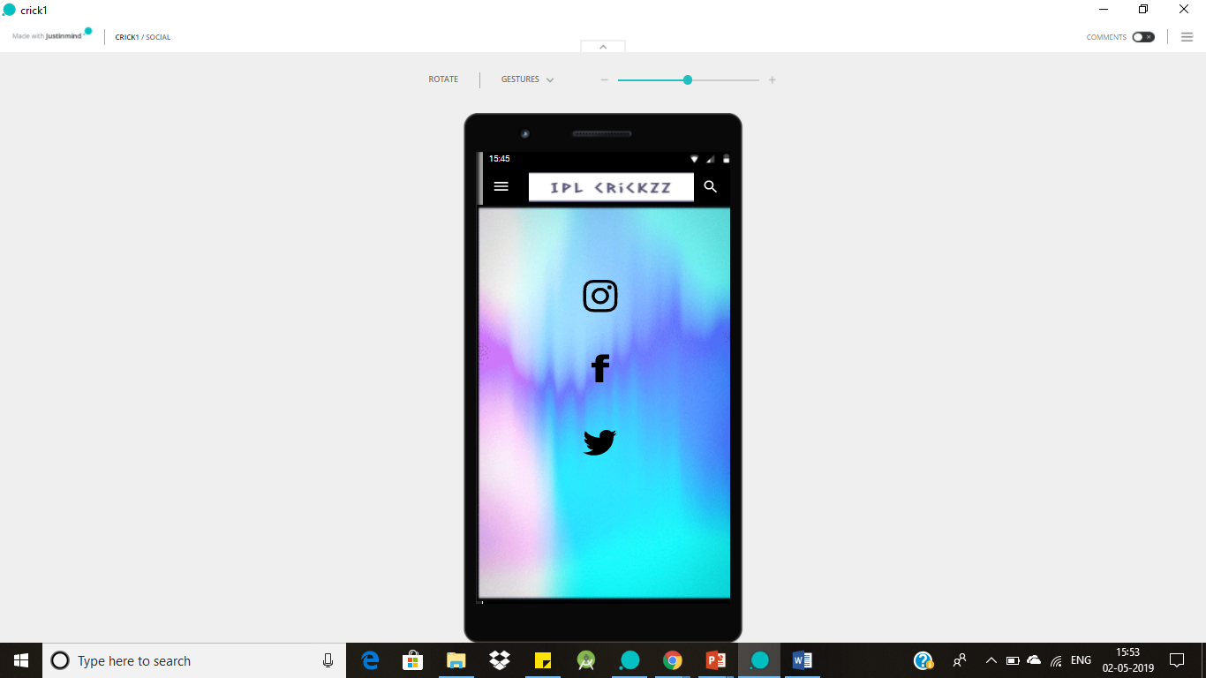
Social Media Screen
The internet changed the way people interact with each other as well as work culture, and those changes first arose on social media sites. That is why social networks for apps are so important.
This screen intimates the users to follow the application in all the mentioned social networking sites for new updates of the application.

Slide 9
THANK YOU

